Slide 1
Insights from the Japans population from 1872 to 2015
A Thinkful Datascience Capstone Project
By Lawrence Quesada

Slide 2


The Data: The Japanese Population Dataset
The Dataset can be found at this url:
https://www.kaggle.com/jd1325/japan-population-data

Slide 3
The Hypothesis:
H₀ - The Population levels remained the same since 1945.
H_{a} - There is a significant difference in the population since 1945.
Audience:
This research shall benefit Economists, Policy Makers, sociologists and students alike.

Slide 4
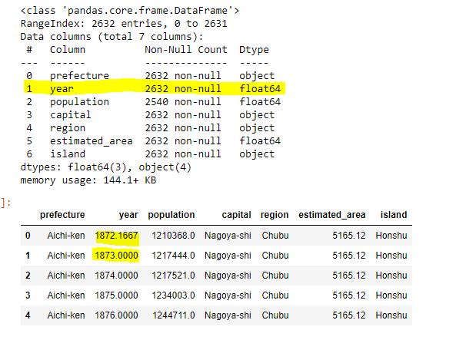
Viewing the Data:

Slide 5
Missing Values:
92 Missing Values in Population.
Dropped the 92 missing values.
It was safe to drop the missing values, as we were still left with a substantial amount of data.

Slide 6
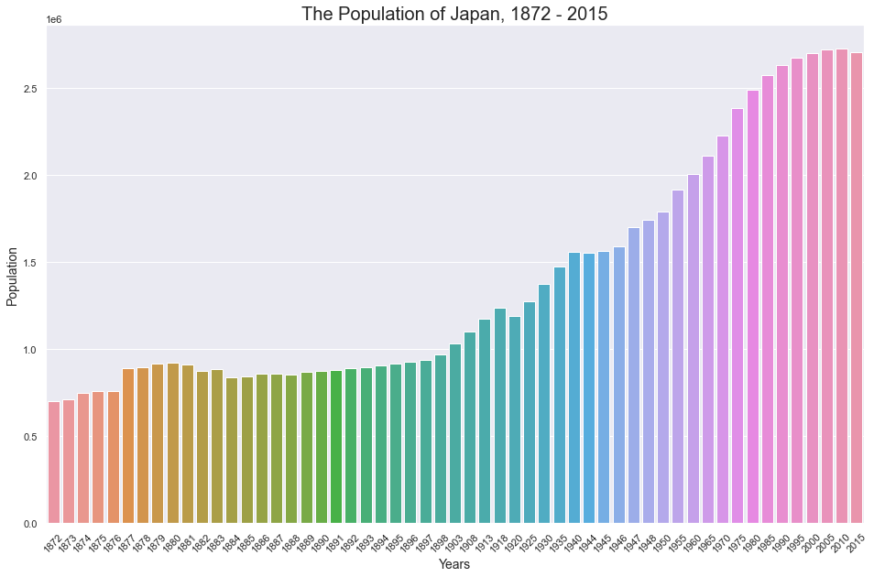
Insights
Increase in population
Healthy Growth

Slide 7
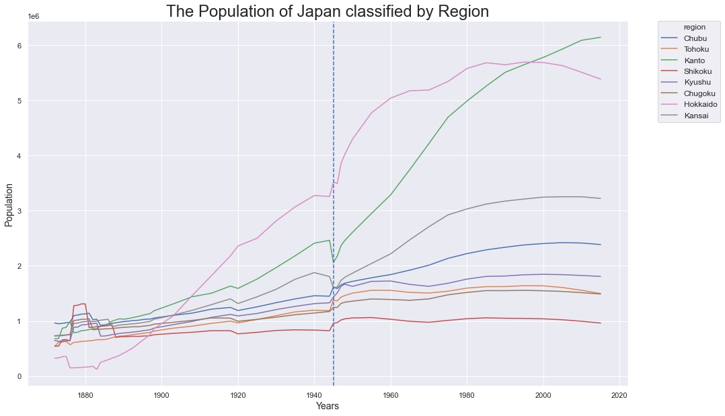
Insights:
Regional Increase?
Decrease?
Same?
Dip around 1945?

Slide 8
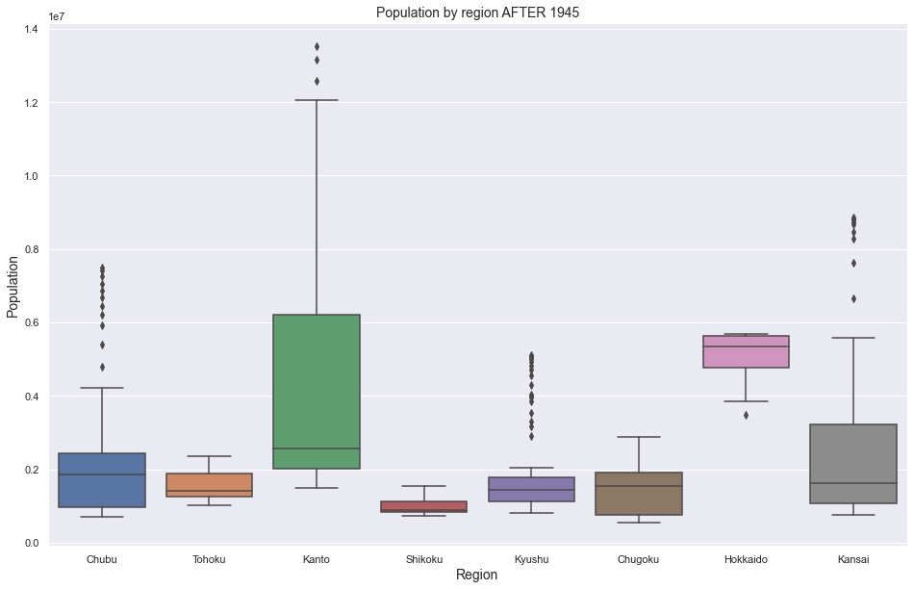
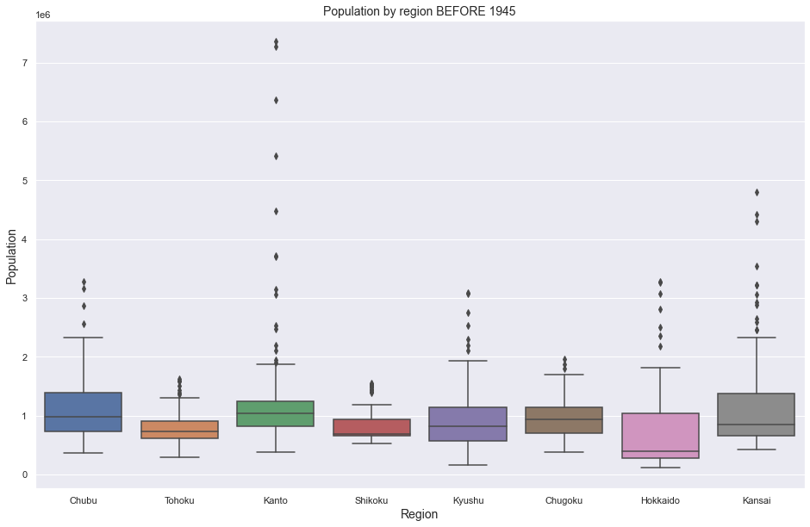
Box Plot to validate first findings
* The scale of the Y-axis is also different. This signifies a change in the population.

Slide 9
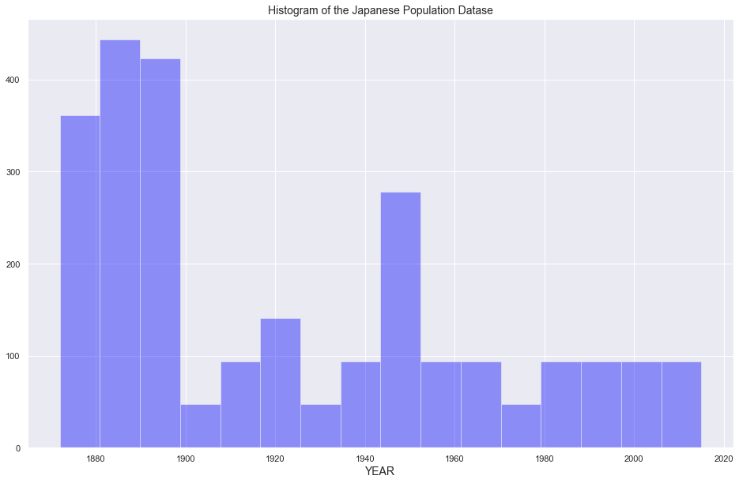
Data Collection Insights

Slide 10
Before 1945 and After 1945 the Kruskal-Wallis test are the following:
Statistic: 1625.78!
P-value: 0.0
* Reject the null hypothesis

Slide 11
REGION | STATISTIC | PVALUE | LOWER CI | UPPER CI
Chubu | 72.70 | 1.503e-17 | 738,480 | 1,235,087
Tohoku | 187.29 | 1.240e-42 | 688,315 | 843,482
Kanto | 208.08 | 3.606e-47 | 2,558,711 | 3,756,211
Shikoku | 41.21 | 1.367e-10 | 129,555 | 290,873
Kyushu | 125.26 | 4.453e-29 | 654,696 | 1,027,499
Chugoku | 27.53 | 1.550e-07 | 357,756 | 677,559
Hokkaido | 34.61 | 4.034e-09 | 3,697,348 | 4,623,261
Kansai | 91.31 | 1.225e-21 | 1,142,076 | 1,980,005

Slide 12
Conclusion:
With a P-value which is less than 5%, we are confident in the difference in post-war and pre-war Japan. It is therefore safe to reject the null Hypothesis.
Considerations and Plans for Additional Research:
A Time Series Analysis
Measurements are dependent on one another.
Looking at 20 years before and after 1945
Further analysis on each of the 47 prefectures.
Rather than just population, look at population growth, birthrate and mortality

Slide 13
Q & A

